Slide 1
J2SE-CORE JAVA
BY-RAHUL KUMAR DIXIT

Slide 2
LECTURE :1
CONTENT
Java Language and its features
How Java is different from C++?
The Java Language – Data types, Variables, Constants, operators, Control Statements (if, for, while,switch etc.)
Classes in java

Slide 3
What is java ?
Java (Object oriented programming language) was conceived by James Gosling, Patrick Naughton, Chris Warth, Ed Frank, and Mike Sheridan at Sun Microsystems, Inc. in 1991
It took 18 months to develop the first working version.
Initially named Oak but renamed java in 1995.
Sun Microsystems has renamed the new J2 versions as Java SE, Java EE and Java ME respectively. Java is guaranteed to be Write Once, Run Anywhere.

Slide 4
Why java is important to the internet?
Java is used to create two type of program:
1. Application
2. Applet
Application is a program that runs on your computer under the O.S., when used to create application , it is not much different from any other language.
Applet is an intelligent program and that can react to user input and dynamically change.
and designed to be transmitted over the internet and executed by java compatible browser.

Slide 5
ByteCode
Bytecode is a highly optimized set of instructions designed to be executed
by the Java run-time system, which is called the Java Virtual Machine (JVM).
JAVA INTERPRETER FOR MAC
JAVA INTERPRETER FOR WINDOWS
JAVA PROGRAM
COMPILER
BYTE CODE
JAVA INTERPRETER FOR UNIX

Slide 6
The key that allows Java to solve both the security and the portability problems just described is that the output of a Java compiler is not executable code.
The JVM is an interpreter for bytecode.
It also helps to make system secure. Because the execution of every Java program is under the control of the JVM.
Because the execution of every Java program is under the control of the JVM

Slide 7
Features of java:
Simple:
Java is designed to be easy to learn and use
Java inherits the C/C++ syntax and many of the object-oriented features of C++, so far C++ programmer, moving to Java will require very little effort.
It makes an effort not to have surprising features , so java does not support pointer, multiple inheritance etc.
Secure:
Java program are Confined to java execution environment and not allowed to access other part of the computer.

Slide 8
Portable:
Java Programs (bytecode) can be execute in any environment for which there is a java run time system.(JVM)
Java programs can be run any platform.(e.g. Linux, windows, Mac)
Java program can be transferred over world wide web.(e.g.Applet)
Object-oriented:
Java is an Object Oriented Language.
Like C++ java provide most of the Object Oriented features.
All Program Code and data resides within objects and classes.

Slide 9
Robust:
Java is strictly type language, so it checks code at compile time.
Java also checks code at run time by means of Exception handling etc. (So bugs are turn up)
Java manages memory allocation and deallocation (by using auto garbage collector ) so no possibility of memory leaks.
Multithreaded:
With Java's multithreaded feature it is possible to write programs that can do many tasks simultaneously.
This design feature allows developers to construct smoothly running interactive applications.

Slide 10
Distributed:
Java is designed as a distributed language fo creating application on networks.
Application can be opened an accessed remotely by remote method application.(RMI)
Dynamic:
Java is dynamic language more than C/C++.
Design to adapt evolving environment .
Java program can carry extensive amount of runtime information , that can used to verify and resolve accesses to objects at runtime.
Java is capable of dynamic linking in methods, objects and new class libraries.

Slide 11
Difference between java and C++.
Both Java and C++ support object oriented programming, yet there are differences between them.
C++ JAVA
Without a preprocessor, there are no provisions for including header files.
C++ supports classes, structures.
All stand-alone C++ programs require a function named main and can have numerous other functions, including both stand-alone functions and functions, which are members of a class.
Java does not support typedefs, defines, or a preprocessor.
Java supports classes , but doesn't support structures or unions.
There are no stand-alone functions in Java. Instead, there are only functions that are members of a class, usually called methods.

Slide 12
C++
JAVA
The Scope resolution (::) ,the pointer operator (->), used in C++.
C++ Support multiple inheritance.
C++ support operator overloading.
C++ supports constructor that may be overloaded. If we fail to provide a constructor, a default constructor will be provided us.
C++ Supports Destructor to deallocate the memory allocated by the constructor.
These operators are not required in java.
Java does not support multiple inheritance. To some extent, the interface feature provides the desirable features of multiple inheritance to a Java program without some of the underlying problems.
Java doesn’t support operator overloading.
Like C++, Java supports constructors that may be overloaded. the default constructor is not provided automatically.
There are no destructors in Java. Unused memory is returned to the operating system by way of a garbage collector.

Slide 13
Two Paradigm of object oriented programming
A program can be conceptually organized around its code or around its data.
what is happening
who is being affected
The first way is called the process-oriented model.
Code acting on data.
Programs grow larger and more complex.
To manage increasing complexity, the second approach, called object-oriented programming.
Set of well-defined interfaces to that data.
Data controlling access to code.

Slide 14
Abstraction
An essential element of object-oriented programming is abstraction.
Manage complexity
Abstraction refers to act of representing essential feature without including the back ground detail or explanations.

Slide 15
Object Oriented Principle
There are three principle that help to implement object oriented model.
Encapsulation
Inheritance
Polymorphism

Slide 16
Encapsulation
Encapsulation is a mechanism that binds together code and data it manipulates, and keeps both safe from outside interference and misuse.
Encapsulation is the technique of making the fields in a class private and providing access to the fields via public methods.
Access to the data and code is tightly controlled by an interface.
BENEFITS:
The fields of a class can be made read-only or write-only.
A class can have total control over what is stored in its fields.
The users of a class do not know how the class stores its data. A class can change the data type of a field and users of the class do not need to change any of their code.

Slide 17
Inheritance
Inheritance is the process by which one object acquires the properties of another object.
It support the concept of hierarchical classification.
In OOP, the concept of inheritance provides the idea of reusability. This means we can add additional features to an existing class without modifying it.
The most commonly used keyword would be extends and implements.

Slide 18
Polymorphism
Polymorphism is a greek term, means the ability to take more than one form.
The specific action is determined by the exact nature of the situation.

Slide 19
A First Simple Program
/*This is a simple Java program.
Call this file "Example.java".
(Multiple line comment) */
class Example {
// Your program begins with a call to main().(single line comment)
public static void main(String args[]) {
System.out.println("This is a simple Java program.");
}
}
Note: SET PATH=“C:\Program Files\java\jdk\bin”

Slide 20
Lexical Issues
Java programs are a collection of whitespace, identifiers, comments, literals, operators, separators, and keywords.
Whitespace: Java is a free-form language. This means that you do not need to follow any special indentation rules.
Identifiers: It is used for class names, method names, and variable names. It is sequence of uppercase and lowercase letters, numbers, or the underscore and dollar-sign characters.
E.g Some examples of valid identifiers are:
Avg Temp count a4 $test this_is_ok
Invalid variable names include:
2count high-temp Not/ok

Slide 21
Comments: The contents of a comment are ignored by the compiler.
multiline comment: begin with /* and end with */.
/*
This is a simple Java program.
Call this file "Example.java".
*/
A single-line comment begins with a // and ends at the end of the line.
// Your program begins with a call to main().
The third type is called a documentation comment.
The documentation comment begins with a /** and ends with a */.

Slide 22
Separators
Symbol
( )
{ }
[ ]
;
,
.

Slide 23
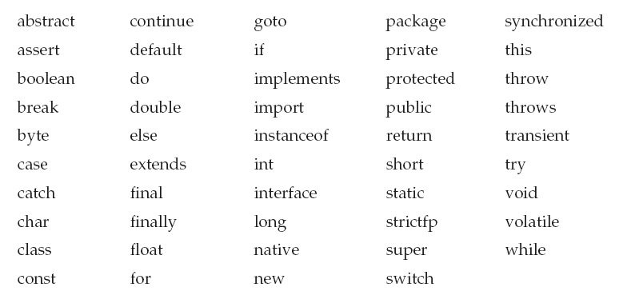


The Java Keywords

Slide 24
Access specifier
class member is preceded by public, then that member may be accessed by code outside the class in which it is declared.
Private, which prevents a member from being used by code defined outside of its class.
Protected applies only when inheritance is involved. The protected is accessible by the member functions with in its class and any class immediately derived from it. It can’t accessed by the method outside this classes.
The keyword static allows main( ) to be called without having to instantiate a particular instance of the class. This is necessary since main( ) is called by the Java interpreter before any objects are made.
System is a predefined class that provides access to the system
out is the output stream that is connected to the console.

Slide 25
DATA TYPES:
Java defines eight simple (or elemental) types of data: byte, short, int, long, char, float, double, and boolean. These can be put in four groups:
Integers This group includes byte, short, int, and long, which are for whole-valued signed numbers.
Floating-point numbers This group includes float and double, which represent numbers with fractional precision.
Characters This group includes char, which represents symbols in a character set, like letters and numbers.
Boolean This group includes boolean, which is a special type for representing true/false values.

Slide 26
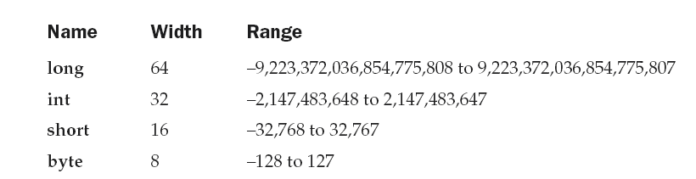
INTEGER
All of these are signed, positive and negative values. Java does not support unsigned, positive-only integers.

Slide 27
VARIABLES
The variable is the basic unit of storage in a Java program. A variable is defined by the combination of an identifier, a type, and an optional initializer. In addition, all variables have a scope, which defines their visibility, and a lifetime.
type identifier [ = value][, identifier [= value] ...] ;
e.g. Variable declarations
int a, b, c; // declares three ints, a, b, and c.
int d = 3, e, f = 5; // declares three more ints, initializing
// d and f.
byte z = 22; // initializes z.
double pi = 3.14159; // declares an approximation of pi.
char x = 'x'; // the variable x has the value 'x'.

Slide 28
Dynamic Initialization : Java allows variables to be initialized dynamically.
E.g. here is a short program that computes the length of the hypotenuse of a right triangle given the lengths of its two opposing sides:
// Demonstrate dynamic initialization.
class DynInit {
public static void main(String args[]) {
double a = 3.0, b = 4.0;
// c is dynamically initialized
double c = Math.sqrt(a * a + b * b);
System.out.println("Hypotenuse is " + c);
}
}

Slide 29
The Scope and Lifetime of Variables
Java allows variables to be declared within any block.
A block defines a scope.
In Java, the two major scopes are those defined by a class and those defined by a method.
The outer scope encloses the inner scope. This means that objects declared in the outer scope will be visible to code within the inner scope. However, the reverse is not true. Objects declared within the inner scope will not be visible outside it

Slide 30
E.g.
// Demonstrate block scope.
class Scope {
public static void main(String args[]) {
int x; // known to all code within main
x = 10;
if(x == 10)
{ // start new scope
int y = 20; // known only to this block
// x and y both known here.
System.out.println("x and y: " + x + " " + y);
x = y * 2;
}
// y = 100; // Error! y not known here
// x is still known here.
System.out.println("x is " + x);
}
}

Slide 31
E.g.
// Demonstrate lifetime of a variable.
class LifeTime {
public static void main(String args[]) {
int x;
for(x = 0; x < 3; x++) {
int y = -1; // y is initialized each time block is entered
System.out.println("y is: " + y); // this always prints -1
y = 100;
System.out.println("y is now: " + y);
}
}
}

Slide 32
Although blocks can be nested, you cannot declare a variable to have the same name as one in an outer scope.
E.g
// This program will not compile
class ScopeErr {
public static void main(String args[]) {
int bar = 1;
{ // creates a new scope
int bar = 2; // Compile-time error – bar already defined!
}
}
}

Slide 33
Type Conversion
It is fairly common to assign a value of one type to a variable of another type.
Java’s Automatic Conversions:
The two types are compatible.
The destination type is larger than the source type.
A widening conversion takes place.
Casting Incompatible Types: To create a conversion between two incompatible types, you must use a cast. A cast is simply an explicit type conversion. A narrowing conversion.
(target-type) value

Slide 34
Example:
// Demonstrate casts.
class Conversion {
public static void main(String args[]) {
byte b;
int i = 257;
double d = 323.142;
System.out.println("\nConversion of int to byte.");
b = (byte) i;
System.out.println("i and b " + i + " " + b);
System.out.println("\nConversion of double to int.");
i = (int) d;
System.out.println("d and i " + d + " " + i);
System.out.println("\nConversion of double to byte.");
b = (byte) d;
System.out.println("d and b " + d + " " + b);
}
}

Slide 35
OUTPUT:
Conversion of int to byte.
i and b 257 1
Conversion of double to int.
d and i 323.142 323
Conversion of double to byte.
d and b 323.142 67

Slide 36
Operator
Java provides a rich operator environment. Most of its operators can be divided into the following four groups:
Arithmetic
Bitwise
Relational
logical

Slide 37
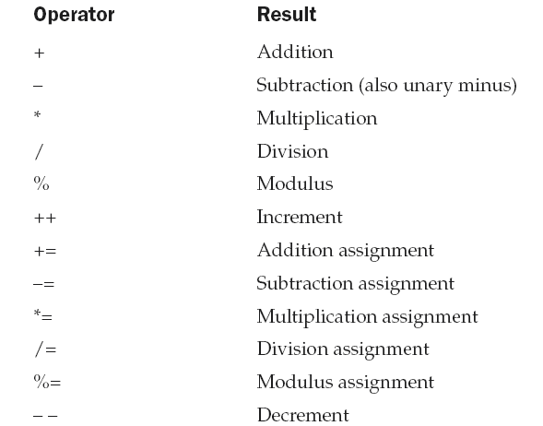
Arithmetic Operators
Arithmetic operators are used in mathematical expressions in the same way that they are used in algebra.

Slide 38
E.g.
// Demonstrate the basic arithmetic operators.
class BasicMath {
public static void main(String args[]) {
// arithmetic using integers
System.out.println("Integer Arithmetic");
int a = 1 + 1;
int b = a * 3;
int c = b / 4;
int d = c - a;
int e = -d;
System.out.println("a = " + a);
System.out.println("b = " + b);
System.out.println("c = " + c);
System.out.println("d = " + d);
System.out.println("e = " + e);

Slide 39
// arithmetic using doubles
System.out.println("\nFloating Point Arithmetic");
double da = 1 + 1;
double db = da * 3;
double dc = db / 4;
double dd = dc - a;
double de = -dd;
System.out.println("da = " + da);
System.out.println("db = " + db);
System.out.println("dc = " + dc);
System.out.println("dd = " + dd);
System.out.println("de = " + de);
}
}

Slide 40
The Modulus Operator
// Demonstrate the % operator.
class Modulus {
public static void main(String args[]) {
int x = 42;
double y = 42.25;
System.out.println("x mod 10 = " + x % 10);
System.out.println("y mod 10 = " + y % 10);
}
}

Slide 41
Array
One Dimensional:
type var-name[ ];
array-var = new type[size];
Auto array: int month_days[] = { 31, 28, 31, 30, 31, 30, 31, 31, 30, 31, 30, 31 };
TWO Dimentisinol:
int twoD[][] = new int[4][5];
Note: int al[] = new int[3];
int[] a2 = new int[3];

Slide 42
Output
When you run this program you will get the following output:
x mod 10 = 2
y mod 10 = 2.25

Slide 43
Arithmetic Assignment Operators
// Demonstrate several assignment operators.
class OpEquals {
public static void main(String args[]) {
int a = 1;
int b = 2;
int c = 3;
a += 5;
b *= 4;
c += a * b;
c %= 6;
System.out.println("a = " + a);
System.out.println("b = " + b);
System.out.println("c = " + c);
}
}

Slide 44
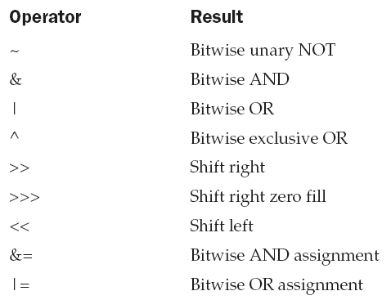
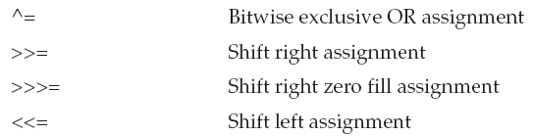
The Bitwise Operators
It can be applied to the integer types, long, int, short, char, and byte.

Slide 45
E.g.
// Demonstrate the bitwise logical operators.
class BitLogic {
public static void main(String args[]) {
String binary[] = {
"0000", "0001", "0010", "0011", "0100", "0101", "0110", "0111",
"1000", "1001", "1010", "1011", "1100", "1101", "1110", "1111"
};
int a = 3; // 0 + 2 + 1 or 0011 in binary
int b = 6; // 4 + 2 + 0 or 0110 in binary
int c = a | b;
int d = a & b;
int e = a ^ b;
int f = (~a & b) | (a & ~b);
int g = ~a & 0x0f;
System.out.println(" a = " + binary[a]);
System.out.println(" b = " + binary[b]);
System.out.println(" a|b = " + binary[c]);
System.out.println(" a&b = " + binary[d]);
System.out.println(" a^b = " + binary[e]);
System.out.println("~a&b|a&~b = " + binary[f]);
System.out.println(" ~a = " + binary[g]);
}
}

Slide 46
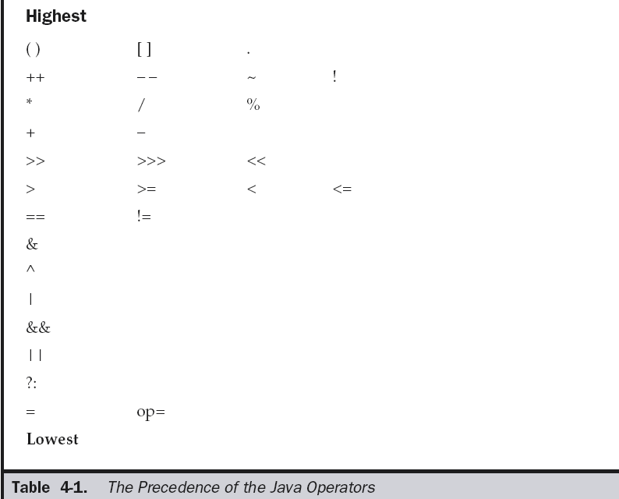
Operator Precedence

Slide 47
switch
switch (expression) {
case value1:
// statement sequence
break;
case value2:
// statement sequence
break;
...
case valueN:
// statement sequence
break;
default:
// default statement sequence
}

Slide 48
// A simple example of the switch.
class SampleSwitch {
public static void main(String args[]) {
for(int i=0; i<6; i++)
switch(i) {
case 0:
System.out.println("i is zero.");
break;
case 1:
System.out.println("i is one.");
break;
case 2:
System.out.println("i is two.");
break;
case 3:
System.out.println("i is three.");
break;
default:
System.out.println("i is greater than 3.");
}
}
}

Slide 49
Jump Statements
Java supports three jump statements: break, continue, and return.
By using break, you can force immediate termination of a loop, bypassing the conditional expression and any remaining code in the body of the loop.
Break work as a label also,

Slide 50
E.g.
// Using break to exit a loop.
class BreakLoop {
public static void main(String args[]) {
for(int i=0; i<100; i++) {
if(i == 10) break; // terminate loop if i is 10
System.out.println("i: " + i);
}
System.out.println("Loop complete.");
}
}

Slide 51
E.g
// Using break as a civilized form of goto.
class Break {
public static void main(String args[]) {
boolean t = true;
first: {
second: {
third: {
System.out.println("Before the break.");
if(t) break second; // break out of second block
System.out.println("This won't execute");
}
System.out.println("This won't execute");
}
System.out.println("This is after second block."); } } }
Output:
Before the break.
This is after second block.

Slide 52
Using continue
Sometimes it is useful to force an early iteration of a loop.
// Demonstrate continue.
class Continue {
public static void main(String args[]) {
for(int i=0; i<10; i++) {
System.out.print(i + " ");
if (i%2 == 0) continue;
System.out.println(""); } } }
Output:
0 1
2 3
4 5
6 7
8 9

Slide 53
